Slide 1

Teddy 3 Verse
Mohith Kumar S S
Under the Guidance of
Prof. Shruthi T S
Head of the Department
Dr. Sridhara S B
Project Co-ordinator
Prof. Rajashree M Bylaw

Slide 2


Problem Statement
Introduction
Modules Identified
System Design of the Project
Implementation
Visualization
Technologies used for Implementation
Existing and Proposed System
Adv and Dis-adv
References
Teddy 3 Verse

Slide 3
Problem Statement
The project aims to develop a comprehensive virtual environment utilizing OpenGL, Python, glm and Pygame to create a visually immersive and interactive experience. However, the existing implementation lacks certain critical features, rendering the virtual environment less realistic and engaging. Therefore, there is a need to address the following problem areas:
Limited Realism: The current implementation fails to provide a high level of realism in terms of lighting, shading and textures, resulting in an unrealistic virtual environment. This restricts users from. Experiencing a visually captivation and immersive environment.
Incomplete Scene Rendering: The existing system lacks the ability to render complex scenes with a large number of objects efficiently. Consequently, the virtual environment suffers from performance issues, including low frame rates and noticeable lag, impacting the overall user experience.
Inefficient Camera Control: The current camera control mechanism does not provide smooth and intuitive navigation within the virtual environment. Users may find it challenging to explore the environment seamlessly, listing their ability to interact effectively with objects and explore various viewpoints.
In light of these challenges, this project aims to overcome the limitations mentioned above by improving the realism, optimizing scene rendering, enhancing camera control, enabling interactive object interactions, and ensuring smooth integration between OpenGL, Python, glm, and Pygame. The proposed solution will provide users with an immersive and engaging virtual environment, delivering a realistic and interactive experience for various application such as gaming, simulations and virtual training.
Teddy 3 Verse

Slide 4
Introduction
OpenGL is a specification that defines Application Programming Interface ( API ) for the GPU to help build 2D and 3D Graphics.
The project is created to interact with virtual environment seamlessly, & by utilizing the help of OpenGL libraries and pygame this graphic engine works efficiently and smoothly compared to programming with C ro C++.
The project implemented here aims to function on lower-end systems providing the best user experience.
Model Rendering, User Interaction, Model Manipulation, User Interface, Performance are achieved in the project.
The project depends on these python files to achieve the required model: Camera.py, scene.py, texture.py, vbo.py, vao.py, model.py, light.py, scene_renderer.py, main.py.
Teddy 3 Verse

Slide 5
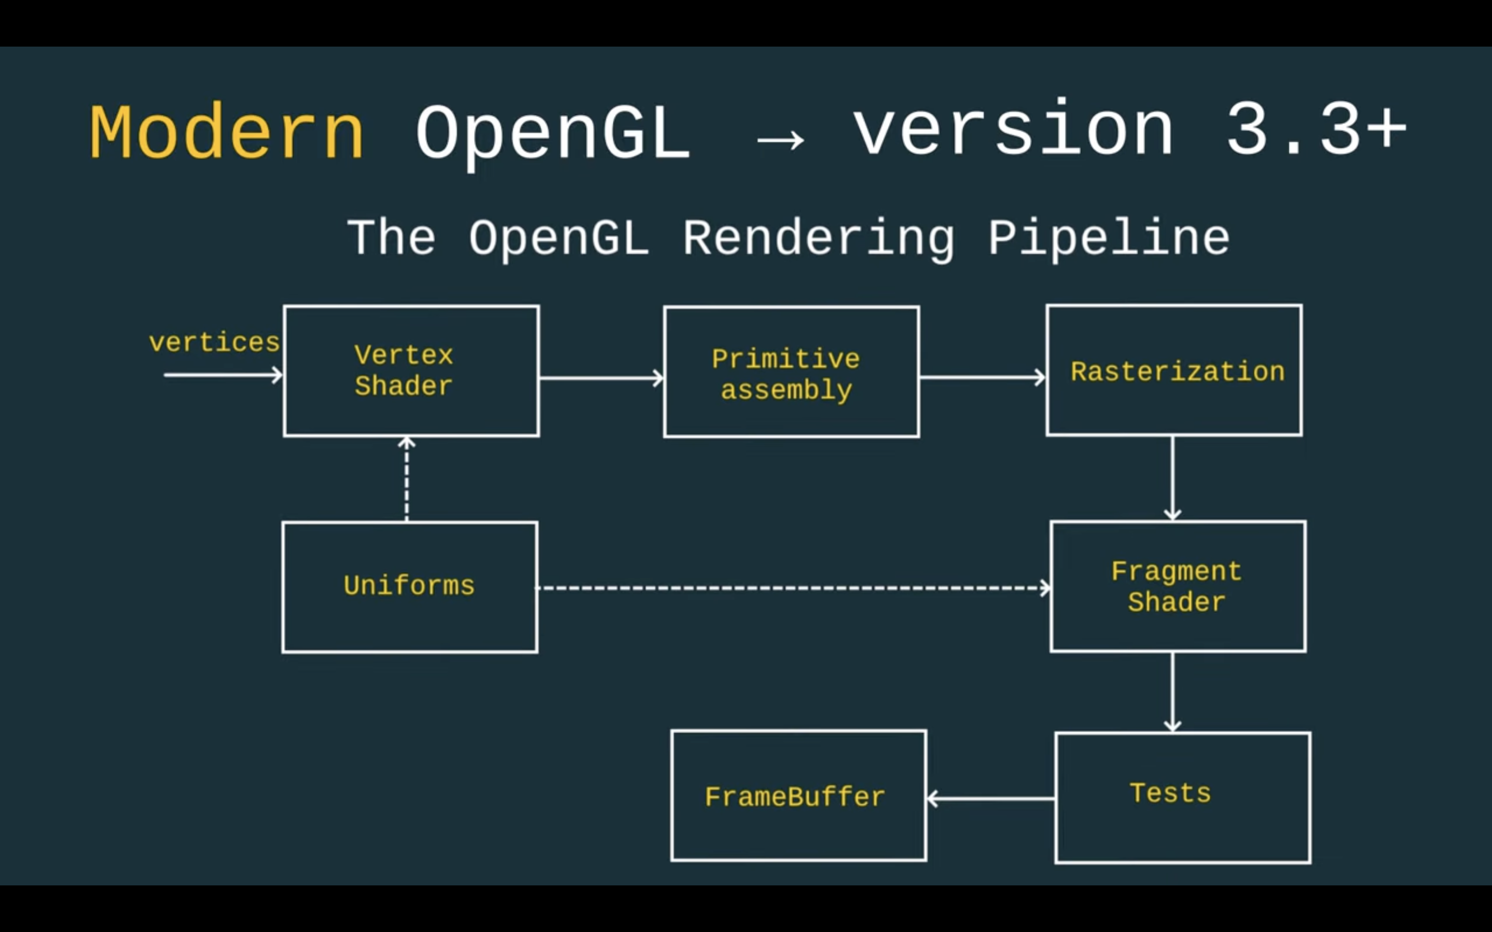
Teddy 3 Verse
Teddy 3 Verse

Slide 6
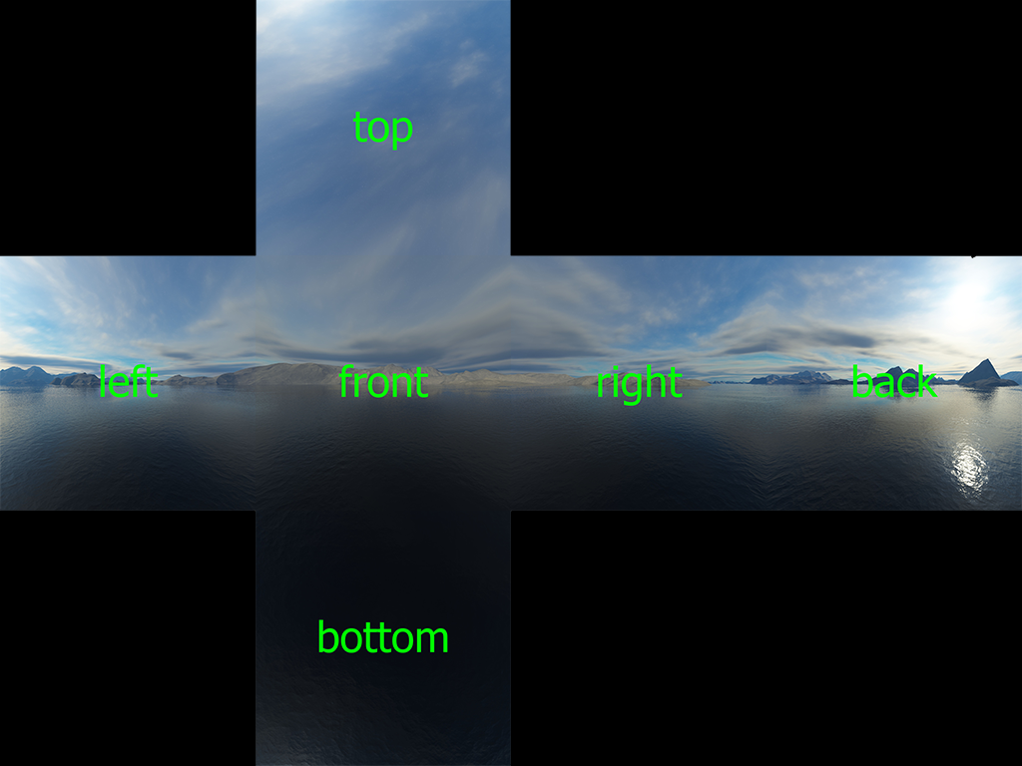
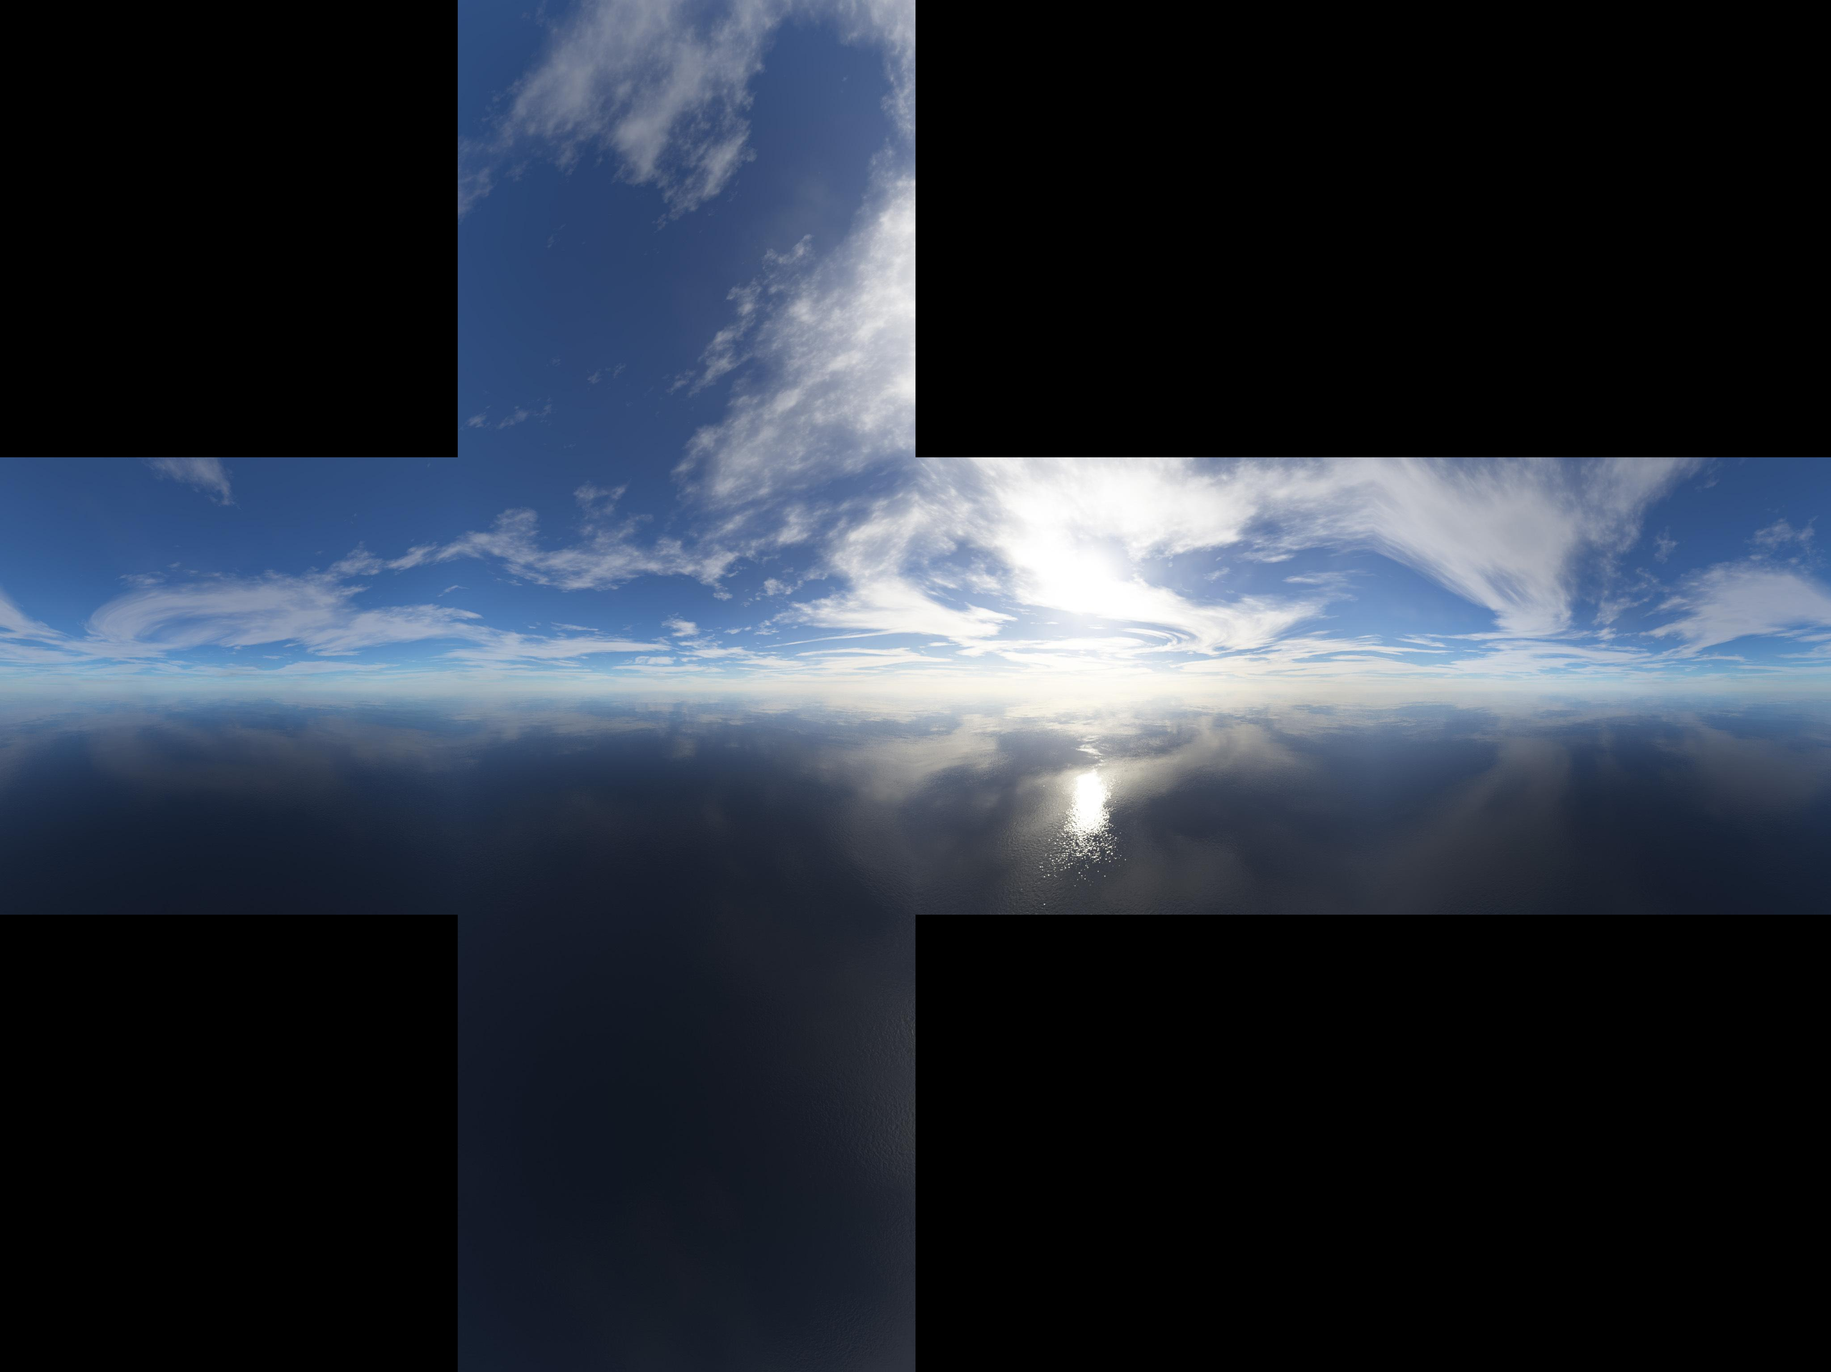
Implementation
Teddy 3 Verse

Slide 7
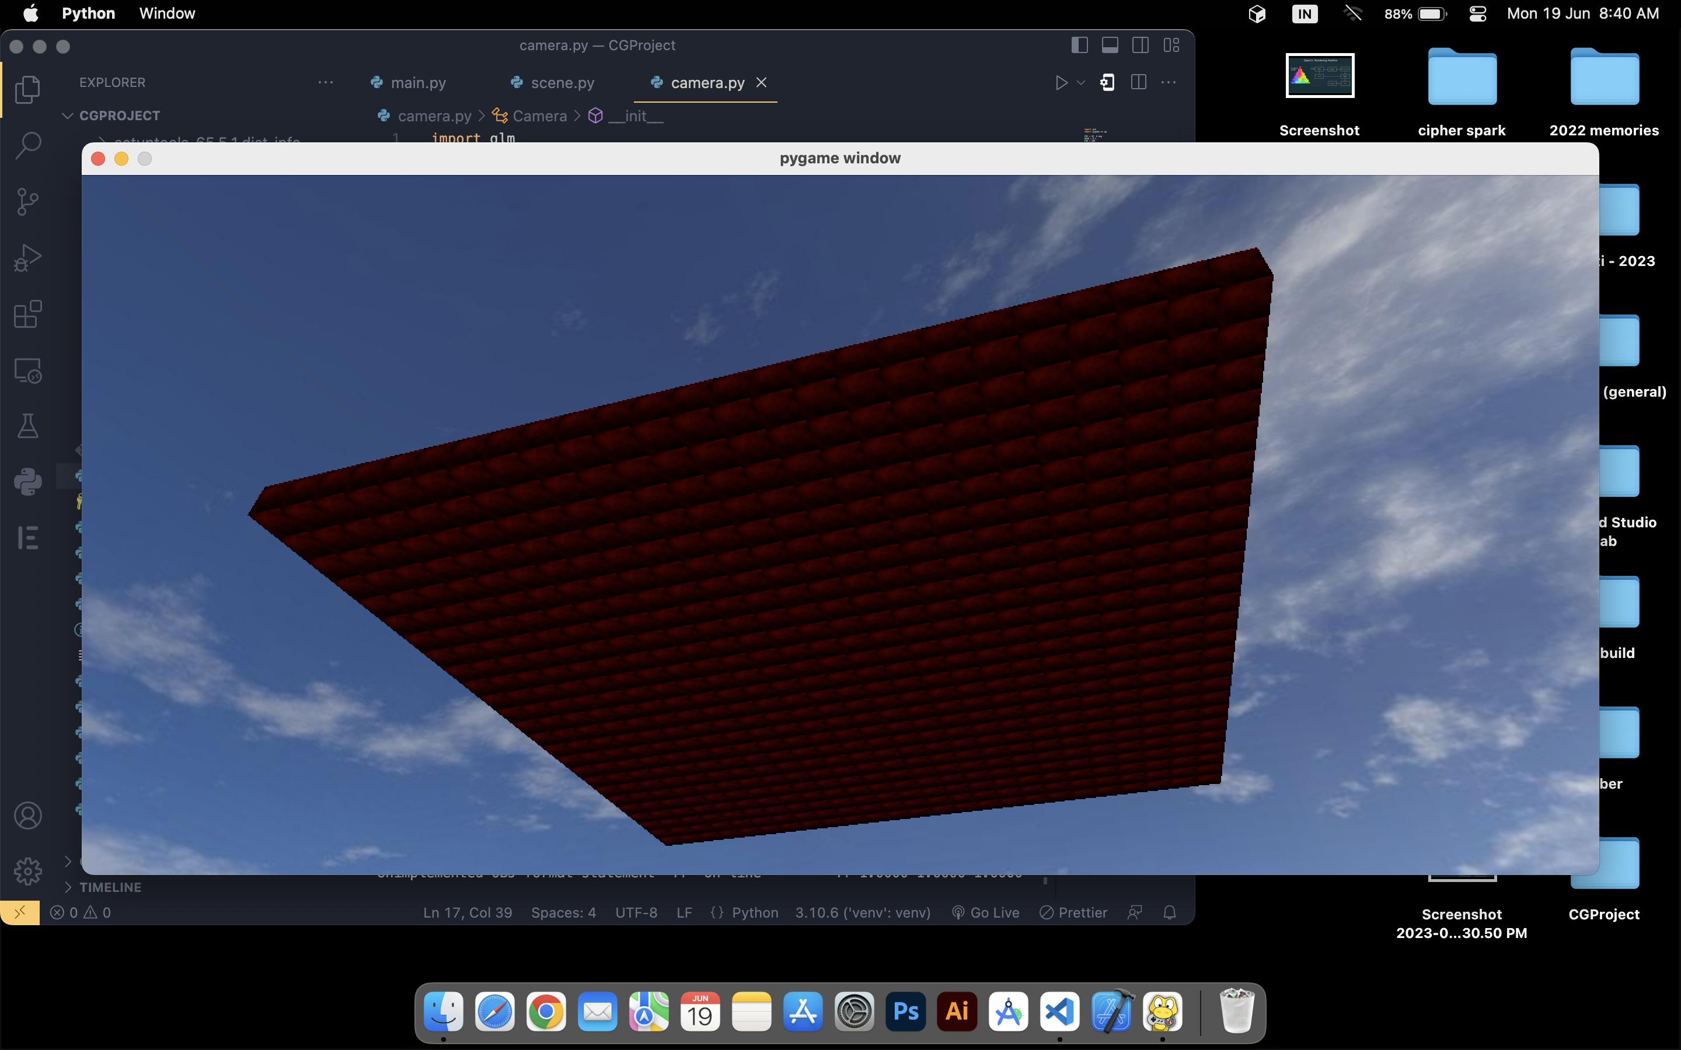
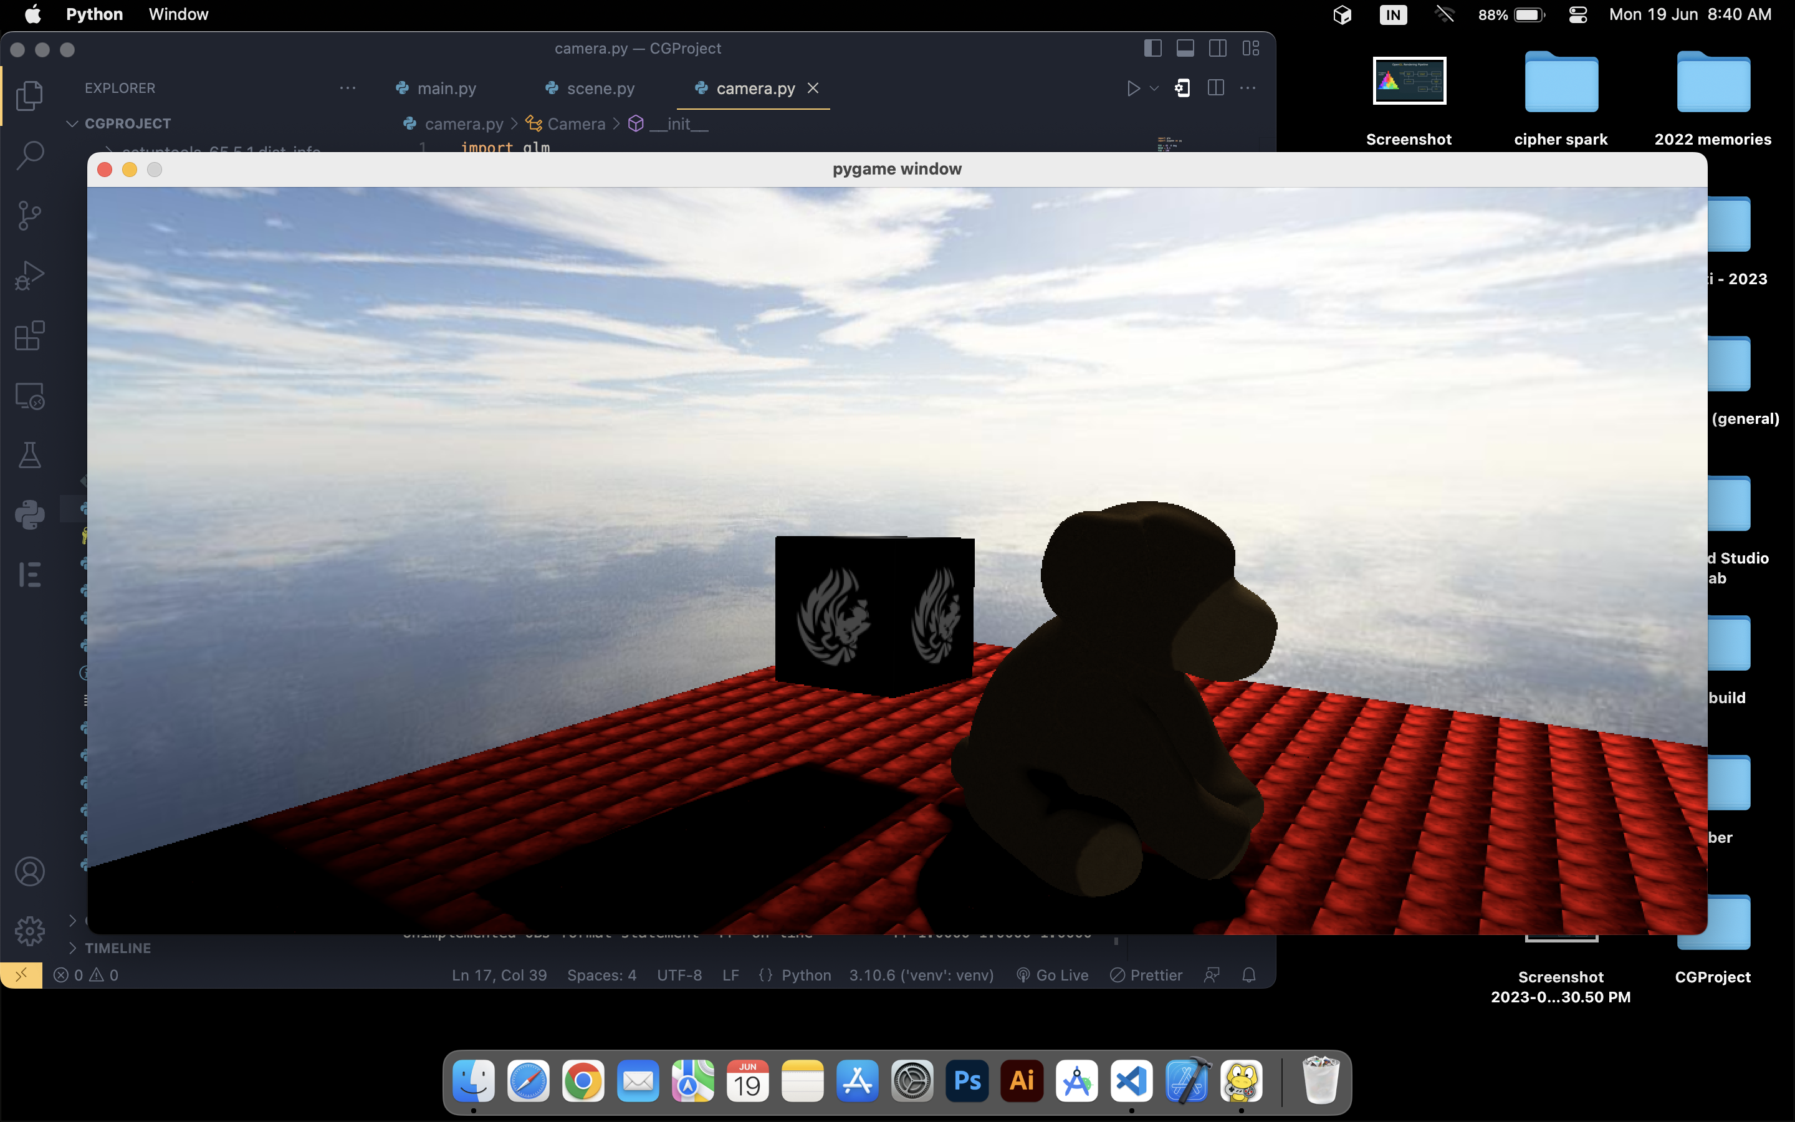
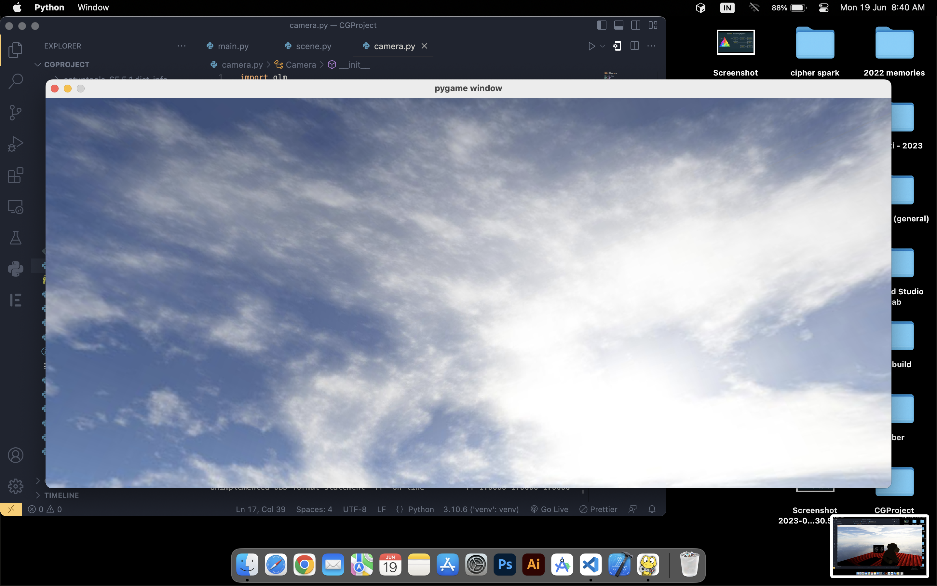
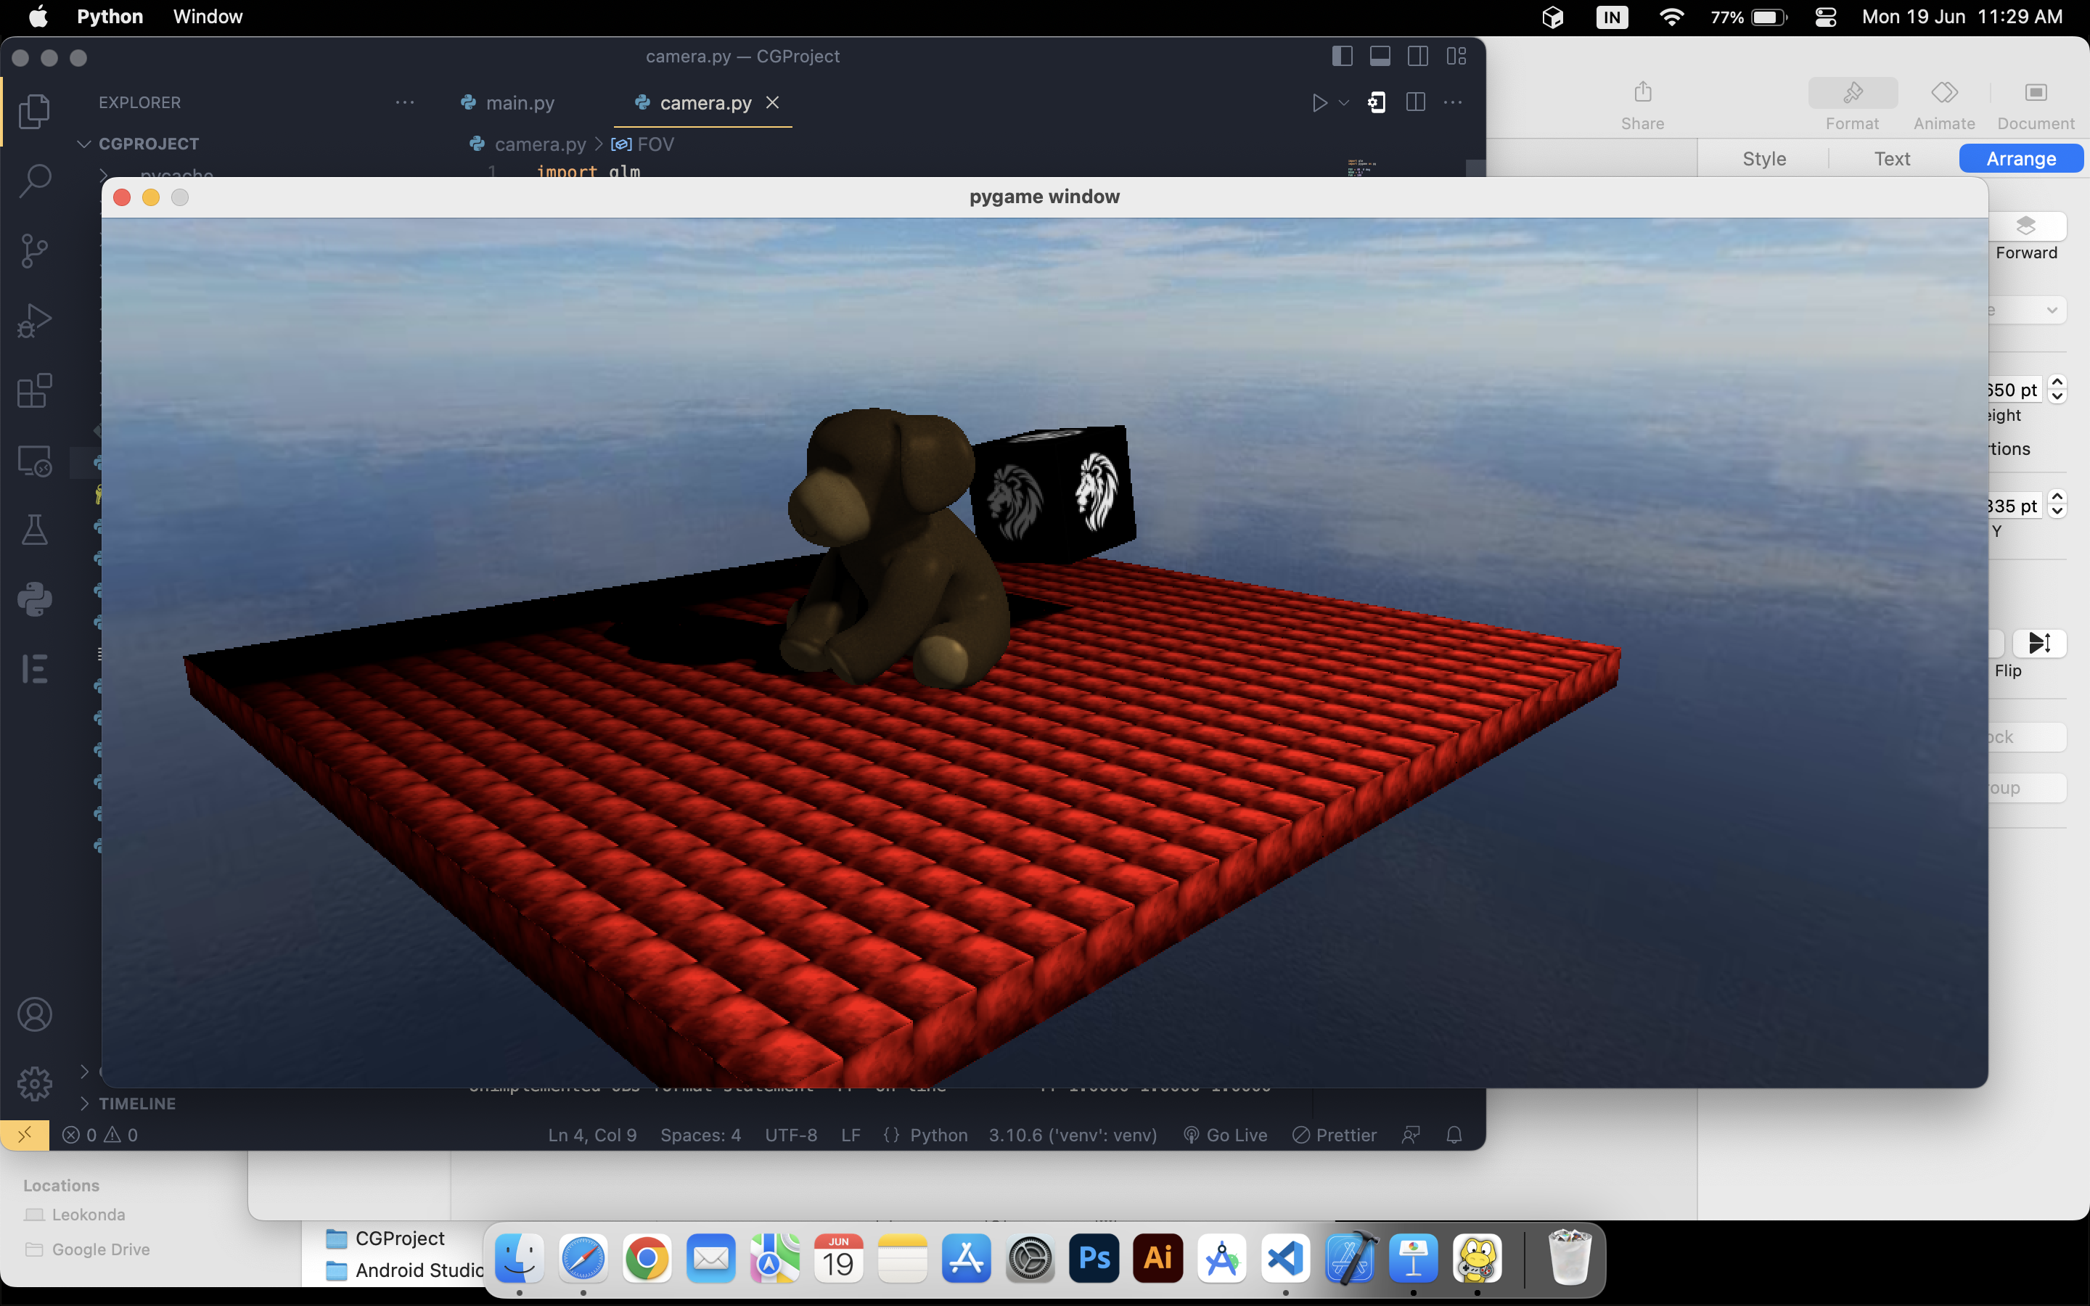

Slide 8
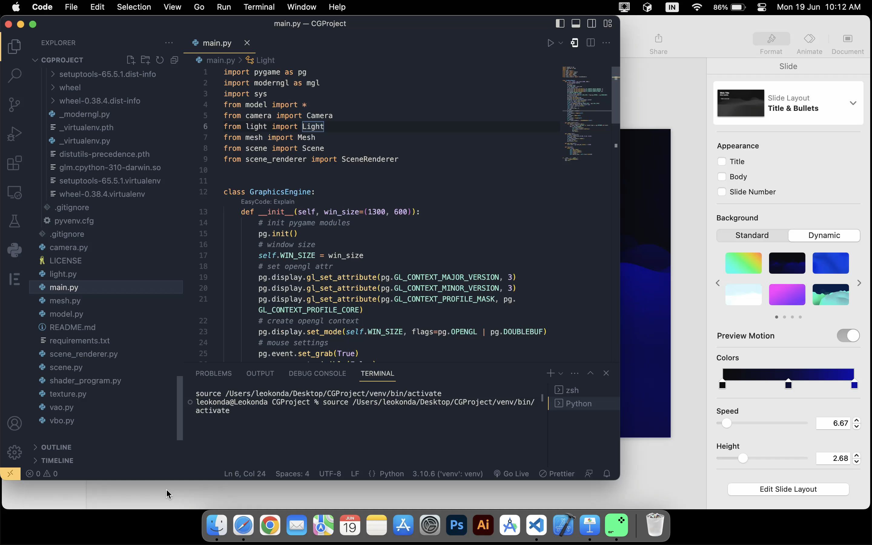

Slide 9
Tech Used for Implementation:
Python for Building the Project
Pygame, glm, Pywavefront libraries and modules.
IDE: VS Code, Pycharm
Teddy 3 Verse

Slide 10
Existing and Proposed System:
The current existing system doesn’t help to render the complex 3D environment, it lacks realistic graphics and involving 3D models.
By using the same libraries of OpenGL, we can render and play with graphics in a realistic, creative way.
The proposed system aims to deliver the topnouch user experience using the low end GPU and systems.
Teddy 3 Verse

Slide 11
Adv Dis Advs
Cross-platform Compatibility
Extensive Libraries
Flexibility and ease of use
Community and resources
Performance limitations
Low Learning Curve
Lack of Advanced features
Logical Complexities
Teddy 3 Verse

Slide 12
References
Pygame Documentation ( https://www.pygame.org/docs/ )
OpenGL YouTube tutorial ( https://www.youtube.com/watch?v=45MIykWJ-C4 )
StackOverflow
GeeksofGeeks
Python Documentation ( https://docs.python.org/3/ )
Teddy 3 Verse

Slide 13
THANK YOU
Department of Computer Science and Engineering
Mohith Kumar S S
Teddy 3 Verse

